Slide 1
GENETICS
By:
M.S SCHOOL,
2nd BASAI ROAD , NH2 HIGHWAY,
TUNDLA ,FIROZABAD.

Slide 2
Definition of Genetics
Generally genetics is the science of study of inheritance.
By definition “ genetics is the science that deals with the structure , organization , transmission , and function of genes and origin of variation.”
It can also be defined “ Genetics is the field of science that examines how trait (characters) are passed from one generation to next generation” . It is a blue print of life .
Cytogenetics : study of various aspects of chromosomes and their effects on the development of character of an organism.

Slide 3
DIVISION OF GENETICS
GENETICS
CLASSICAL
MOLECULAR
POPULATION
QUANTITATIVE
Genetics is divided in to 4 major division

Slide 4
CLASSICAL GENETICS
Describe how traits ( physical characters) are passed along from one generation to another.
Classical genetics is the branch of genetics based solely on visible results of reproductive acts. It is the oldest discipline in the field of genetics, going back to the experiments on Mendelian inheritance by Gregor Mendel who made it possible to identify the basic mechanisms of heredity. Subsequently, these mechanisms have been studied and explained at the molecular level.
Classical genetics consists of the techniques and methodologies of genetics that were in use before the advent of molecular biology. A key discovery of classical genetics in eukaryotes was genetic linkage. The observation that some genes do not segregate independently at meiosis broke the laws of Mendelian inheritance, and provided science with a way to map characteristics to a location on the chromosomes. Linkage maps are still used today, especially in breeding for plant improvement.

Slide 5
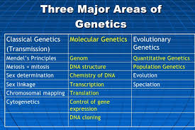

Slide 6
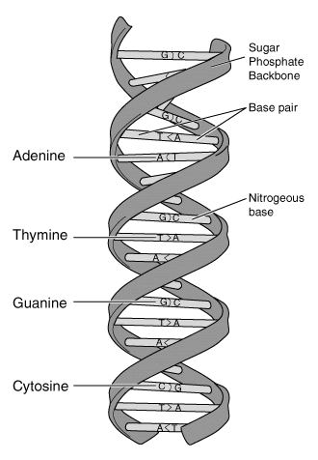
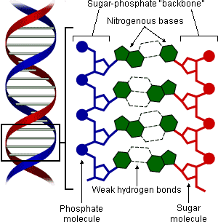
MOLECULAR GENETICS
The study of chemical and physical structures of DNA, its cousin RNA and protiens.

Slide 7
POPULATION GENETICS
Population genetics is a field of biology that studies the genetic composition of biological populations, and the changes in genetic composition that result from the operation of various factors, including natural selection.
Population geneticists pursue their goals by developing abstract mathematical models of gene frequency dynamics, trying to extract conclusions from those models about the likely patterns of genetic variation in actual populations, and testing the conclusions against empirical data.

Slide 8
QUANTITATIVE GENETICS
A highly mathematical field that examines the statistical relationship between genes and trait the possess.
Quantitative genetics is a branch of population genetics that deals with phenotypes that vary continuously (in characters such as height or mass)—as opposed to discretely identifiable phenotypes and gene-products (such as eye-colour, or the presence of a particular biochemical).

Slide 9
METHODS OF STUDYING GENETICS
PEDIGREE ANALYSIS
KARYOTYPING
PLANNED EXPERIMENTAL BREEDING
TWIN STUDY
STATISTICAL ANALYSIS
GENETIC ENGINEERING

Slide 10
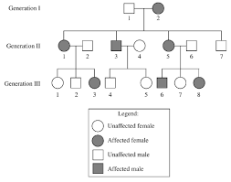
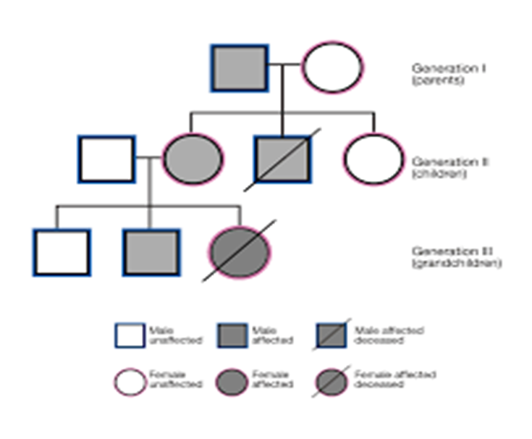
PEDIGREE ANALYSIS
It is used to analyse Individual family defects that has been transferred from one generation to another . Example : Hypertension , diabetes etc.

Slide 11
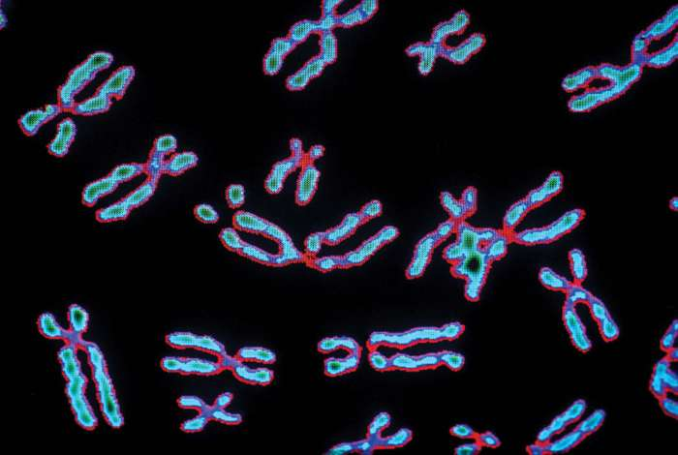
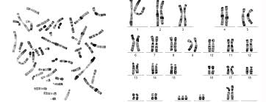
KARYOTYPING
It is used to detect the defect of an individual chromosomes . Example: human being has 23 pairs if chromosomes where one pair is sex chromosome that is 23rd pair . If this 23rd pair happens to be trisomy its an chromosomal defect XXY known as “klinefelter syndrome” where boy is born with an extra ‘X’ chromosome . Where as normal male has ‘XY’ chromosome.

Slide 12
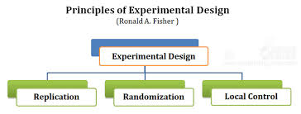
PLANNED EXPERIMENTAL BREEDING

Slide 13

STATISTICAL ANALYSIS

Slide 14
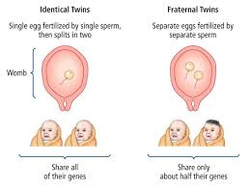
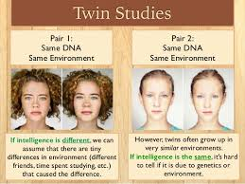
TWIN STUDY

Slide 15
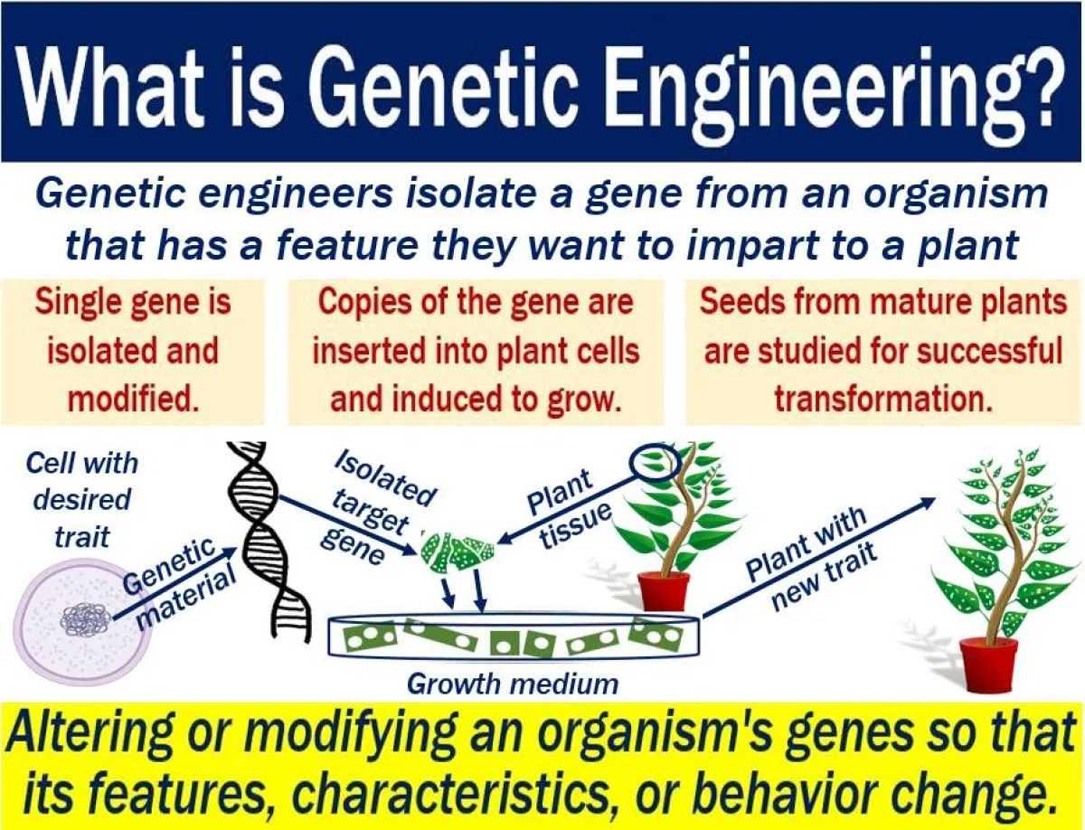
GENETIC ENGINEERING

Slide 16
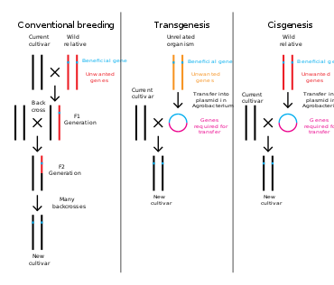

Slide 17
Application of Genetics
Field of medicine
Agricultural
Food production
Industries
Genetic counselling
Genetic code

Slide 18
POINTS TO REMEMBER
1. Genetic is the branch of science that help us study the organisms phenotype and genotype.
2. The term Genetics came from word “Gen” Genetikos mean generation and genesis – beginning.
3. HEREDITY : Transfer of characters from parents to offspring.
VARIATION: similarities and differences.
4. Genetics is further classified in to classical genetics , population genetics , quantitative genetics, molecular genetics.
5. Genetics can be studied and analyzed by various methods where major methods are : Pedigree analysis , Karyotyping , Twin study, Statistical analysis , Genetic engineering etc.
6. Genetics plays an important role in our day to day life for progression in fields such as Agriculture, Medicine, genetic code, etc.

Slide 19
ASSIGNMENT
Q1. Explain genetics in detail?
Q2.In how many division genetics are divided name and explain them in detail with suitable diagram.
Q3. Describe genetic engineering and its methods in detail ? Draw the suitable diagrams for each?
Q4. Draw a pedigree chart of your family with relation to “Daibetes”.
Q5.Enlist the genetic disorders which can be detected by the method of karyotype and draw the chart of each (minimum 5)?
Q6. Write application of genetics?
Q7. Write a passage on experience of lockdown ?

